Slide 1

Pizza Sales Analysis
SQL Data Analysis Project
Tools Used
SQL
By Abhay Yadav

Slide 2
Project Overview
Objective
Analyze pizza sales data to identify revenue patterns and customer behavior
Dataset Used
Orders
Order Details
Pizzas
Pizza Types
Key Focus Areas
Revenue analysis
Top-performing pizzas
Time-based trends

Slide 3
Tools & SQL Concepts Used
Tool Used
SQL
SQL Concepts Applied
Joins
Aggregate Functions (SUM, COUNT, AVG)
GROUP BY and ORDER BY
CTE
Window Functions

Slide 4
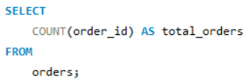

Total Orders
Question:
What is the total number of orders placed?
Input:
Output:

Slide 5
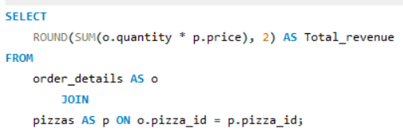

Total Revenue
Question:
What is the total revenue generated from pizza sales?
Input:
Output:

Slide 6
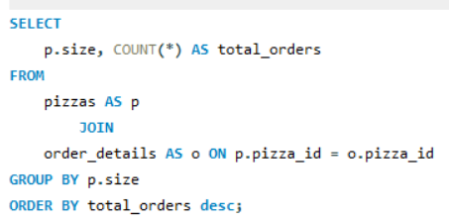
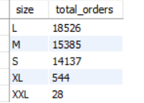
Most Common Pizza Size
Question:
Which pizza size is ordered the most?
Input:
Output:

Slide 7
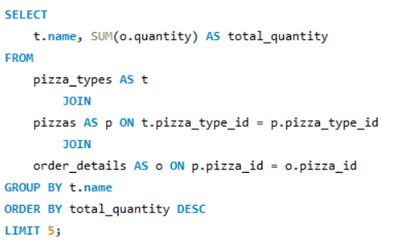
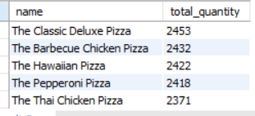
Top 5 Pizza Types by Quantity
Question:
What are the top 5 most ordered pizza types?
Input:
Output:

Slide 8
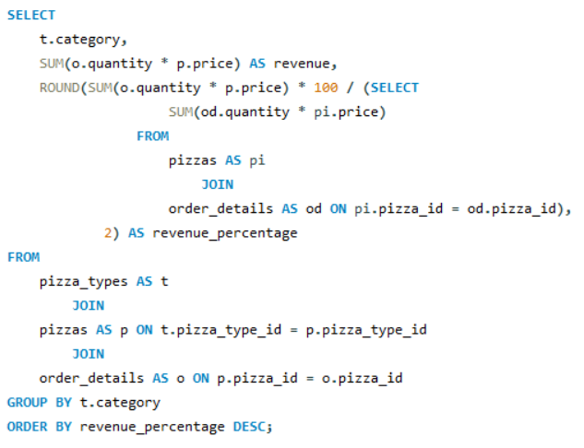
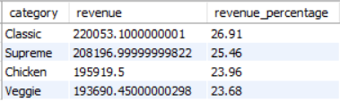
Category-wise Revenue
Question:
Which pizza categories generate the highest revenue?
Input:
Output:

Slide 9
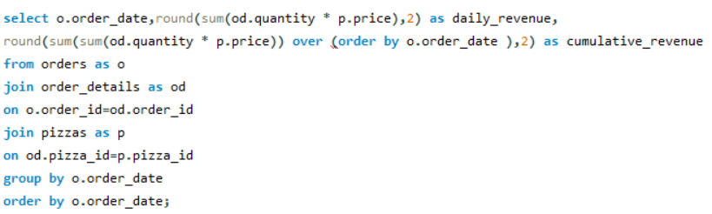
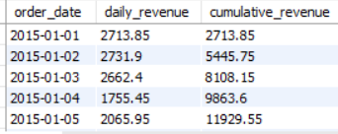
Cumulative Revenue Over Time
Question:
How does revenue grow over time?
Input:
Output

Slide 10
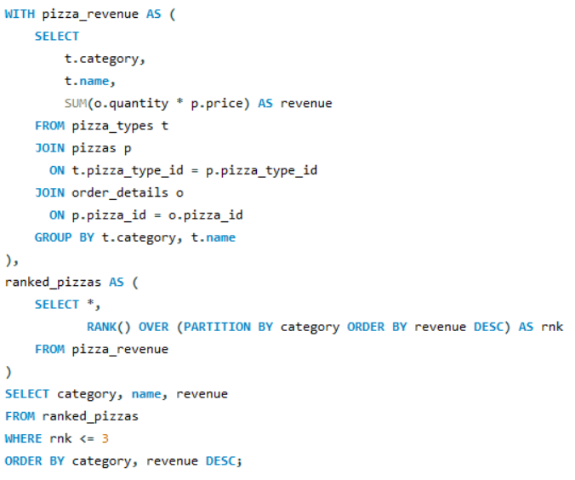
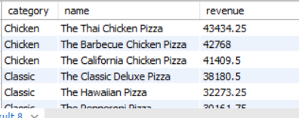
Top 3 Pizza Types per Category
Question:
What are the top 3 pizza types by revenue in each category?
Input:
Output:

